Slide 1
LENDING CLUB CASE STUDY
Solution By
EDWIN MATHEW
ISHKHAN MARZOOK

Slide 2
Outline
Introduction
Analysis Methods
Univariate Analysis
Bivariate Analysis
Recommendation/Observations
Lending Performance Summary

Slide 3
Introduction
Lending Club specializes in lending various loan types to urban customers, these loans can vary across different areas of people's personal life (i.e. medical emergency to weddings).
Two of the biggest risk faced by the company includes
Rejection of loan when the customer is less risky of defaulting
Approval of loan when the customer is highly likely to defaulting
Aim of this data analysis is to understand customer and loan attributes defaulting to avoid rejecting less risky customer and approving high risk customers.

Slide 4
Analysis Methods
Following analysis methods are used to analyze the Lending Case Study Dataset
Univariate Analysis – Analyzing of one variable at a time
Bivariate Analysis – Analyzing of two variable against each other

Slide 5
Univariate Analysis
Following Univariate Analysis performed on Lending Case Study Dataset
Loan Status Analysis
Interest Rate Distribution Analysis
Loan Amount Distribution Analysis
Annual Income Distribution Analysis
Loan Term Analysis
Home Ownership Analysis
Employment Length Analysis
Application Type Analysis
State Analysis
Loan Issued Year Analysis

Slide 6
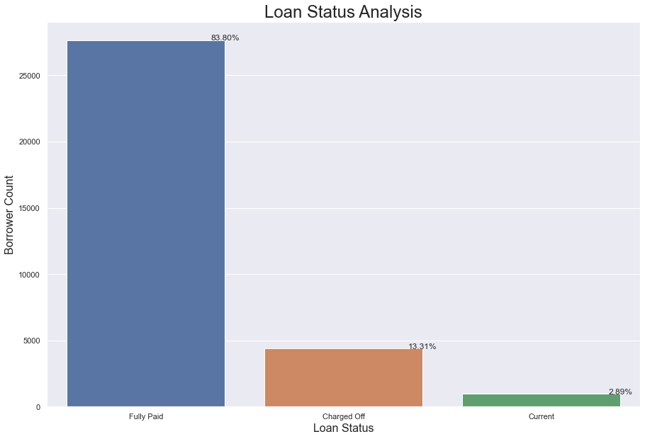
Loan Status Analysis
According to the Loan Status Analysis, we can conclude the following, - 83.80% of the borrowers Fully Paid the loan - 13.31% of the borrowers Charged Off (which means defaulted) - 2.89% of the borrowers are Current (which means in the process of paying the installments)

Slide 7
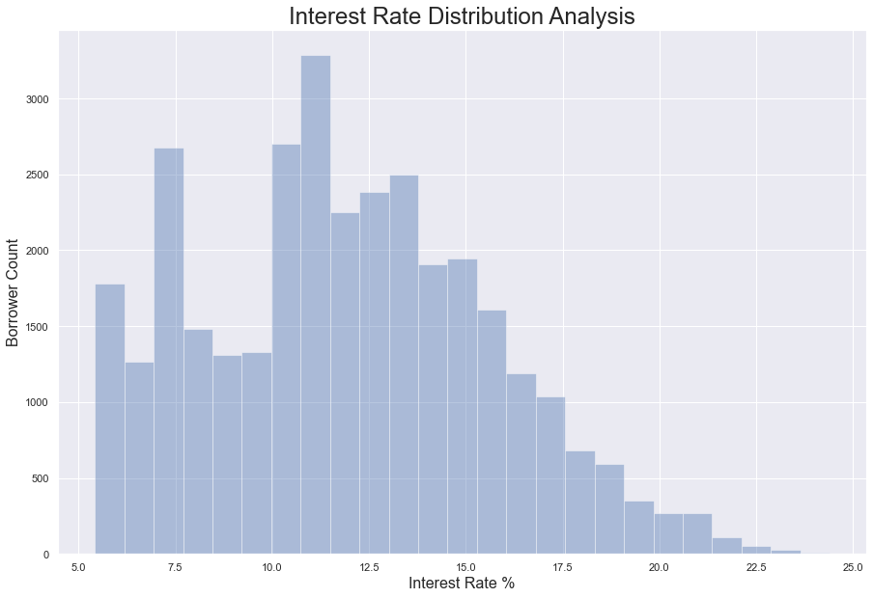
Interest Rate Distribution Analysis
According to the Interest Rate Distribution Analysis, we can conclude the following, - Higher number of loans falling under interest rates between 10% to 15% - Number of borrowers gradually getting reduced when the interest rate is higher than 15%

Slide 8
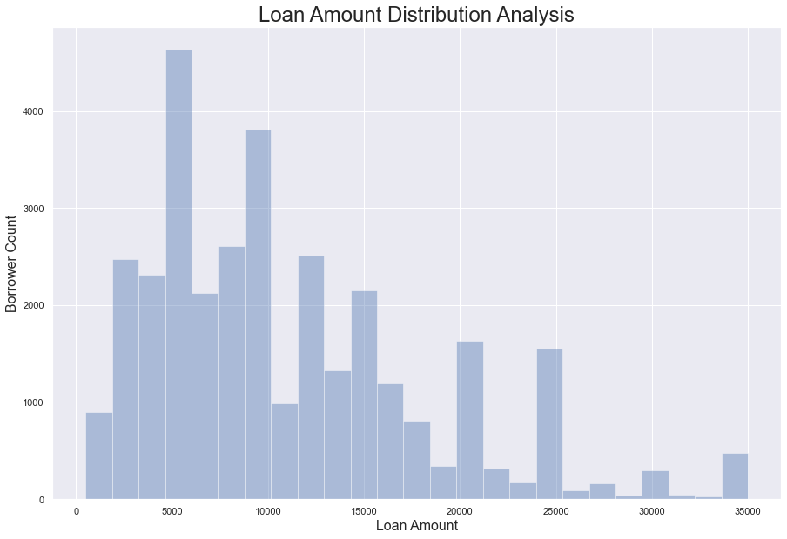
Loan Amount Distribution Analysis
According to the Loan Amount Distribution Analysis, we can conclude the following, - Most of the loan amount falls between 5000 to 10000

Slide 9
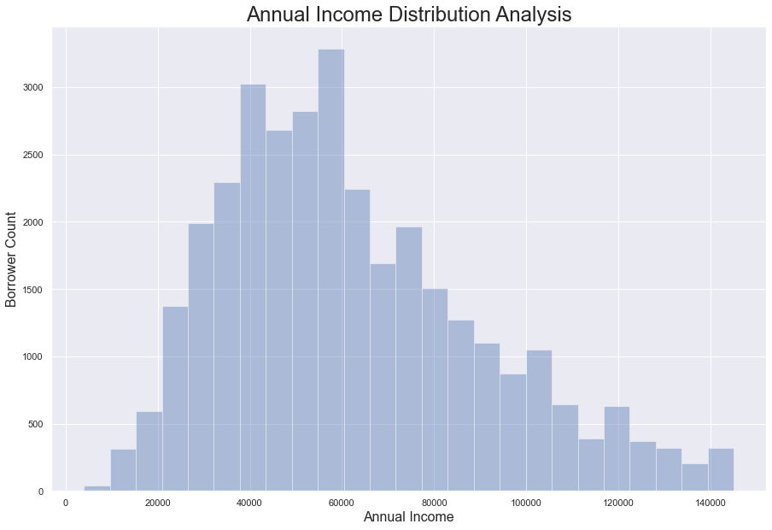
Annual Income Distribution Analysis
According to the Annual Income Distribution Analysis, we can conclude the following, - Most of the borrowers annual income falls between 40000 to 60000 - Borrower count gradually increases for annual income between 5000 to 50000 and decreases for annual income between 60000 to 145000

Slide 10
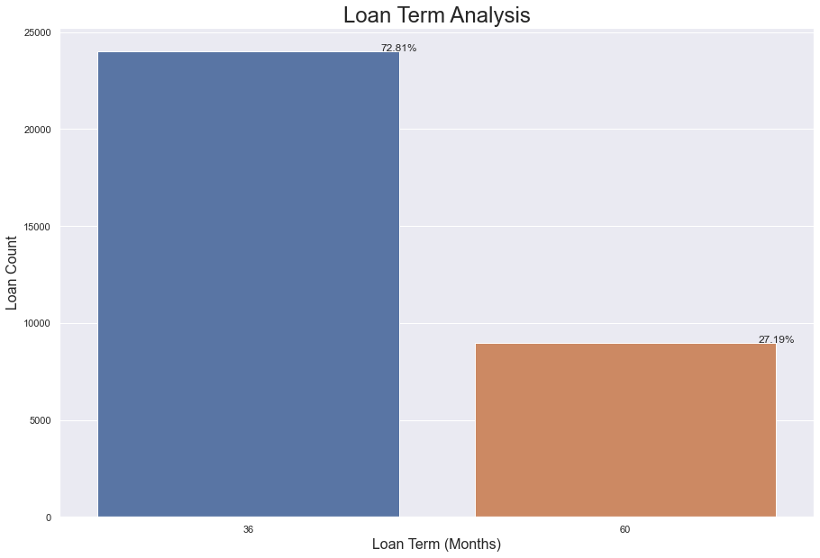
Loan Term Analysis
According to the Loan Term Analysis, we can conclude the following, - 72.81% loans are termed for 36 months - 27.19% loans are termed for 60 months

Slide 11
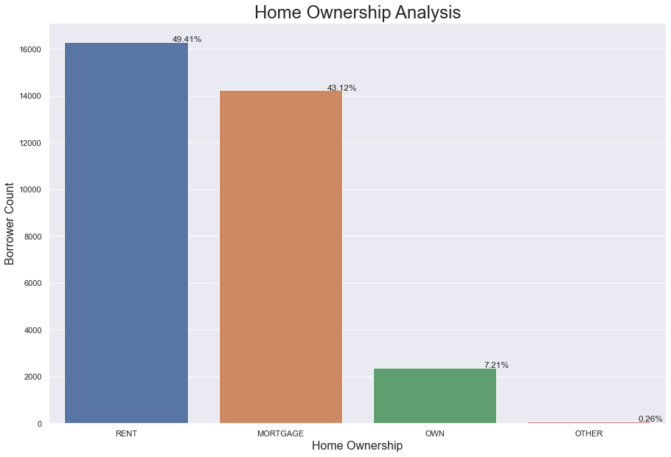
Home Ownership Analysis
According to the Home Ownership Analysis, we can conclude the following, - 49.41% of the borrowers have rent house - 43.12% of the borrowers have mortgage house - 7.21% of the borrowers have own house

Slide 12
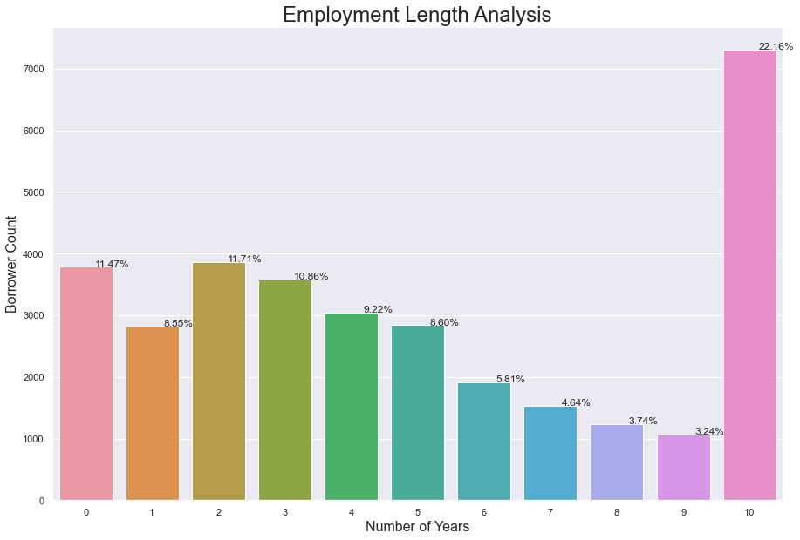
Employment Length Analysis
According to the Employment Length Analysis, we can conclude the following, - Most of the borrowers are employed for 10 or more years

Slide 13
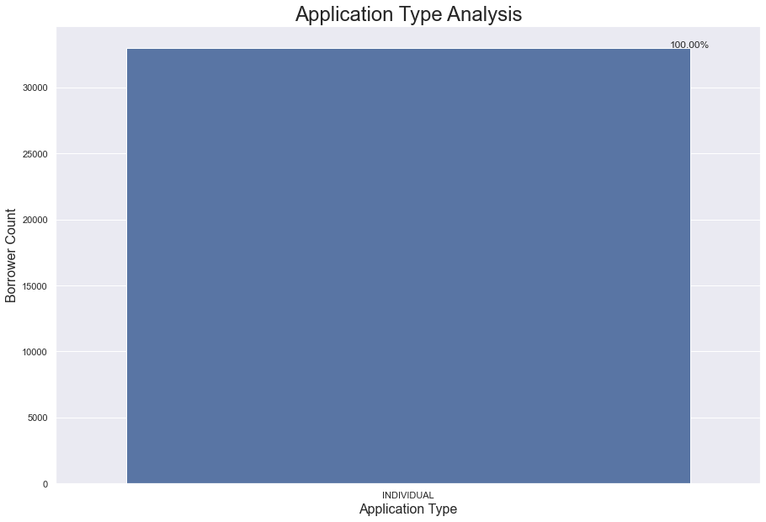
Application Type Analysis
According to the Application Type Analysis, we can conclude the following, - 100% of the borrowers are individual applicants

Slide 14
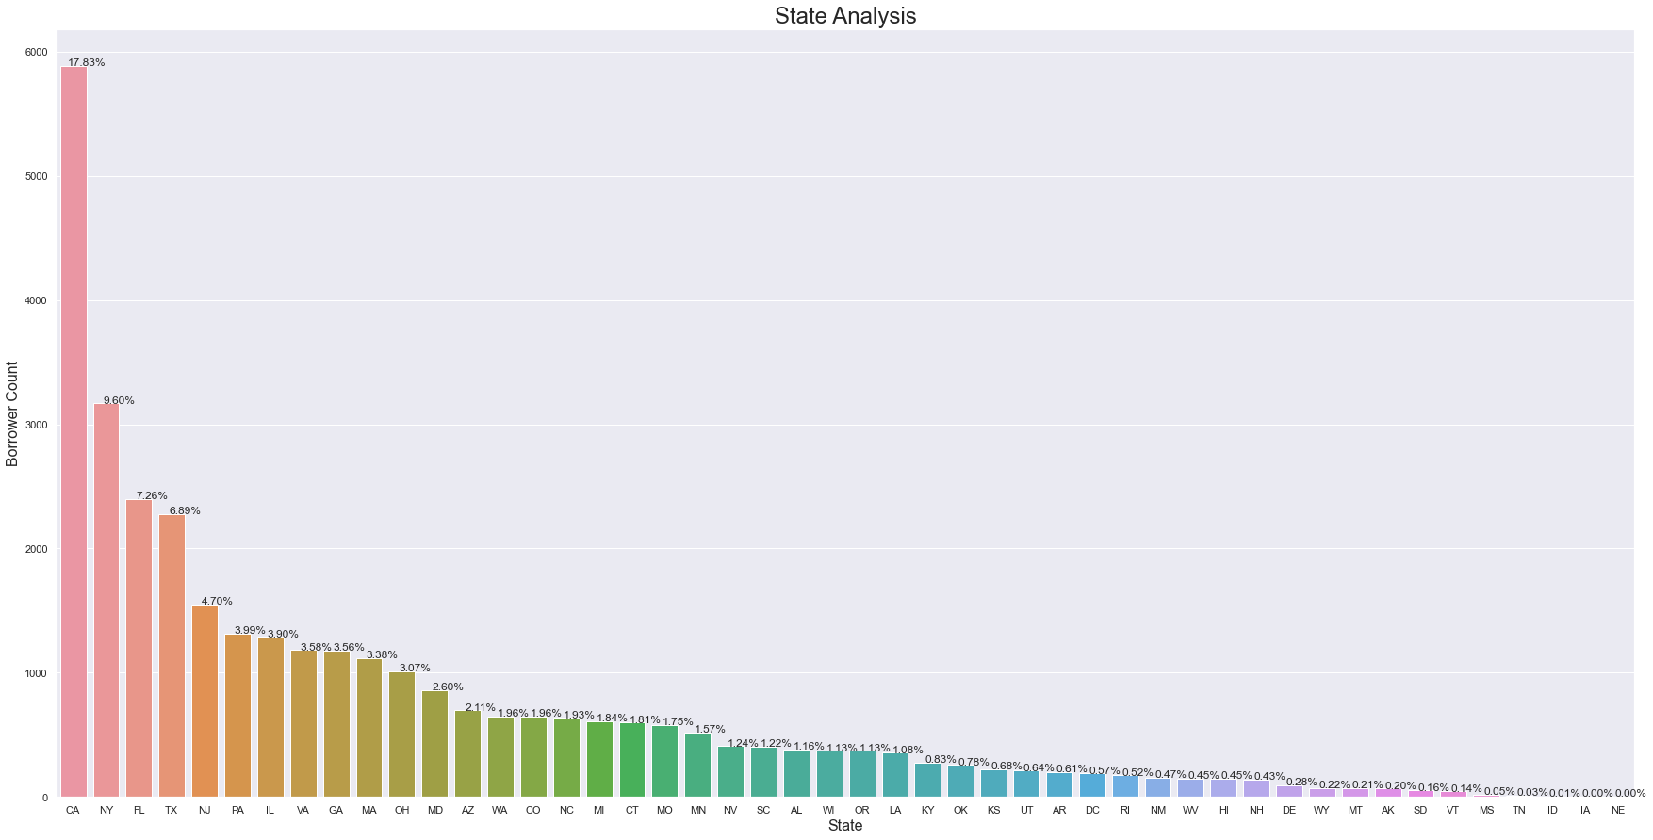
State Analysis
According to the State Analysis, we can conclude the following, - The state CA has the highest number of borrowers and the state NE has the least number of borrowers

Slide 15
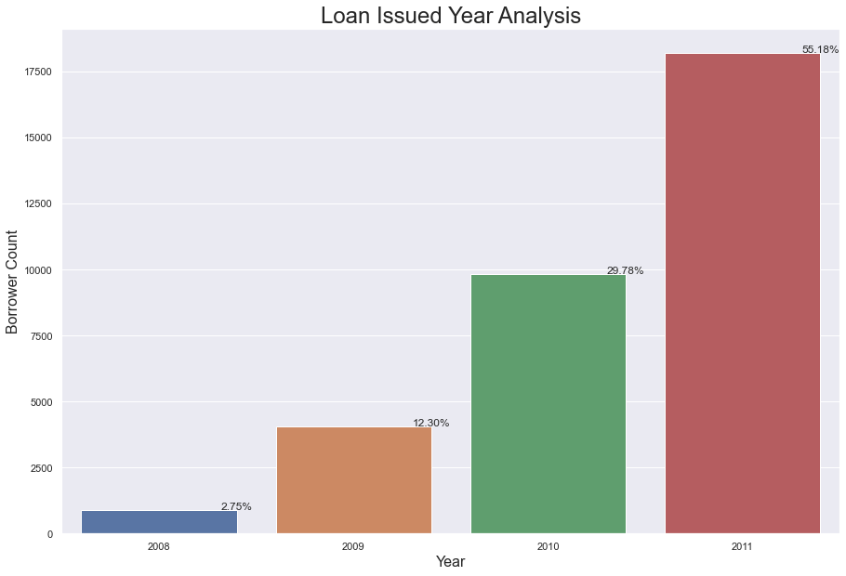
Loan Issued Year Analysis
According to the Loan Issued Year Analysis, we can conclude the following, - Least number of loans issued in 2008 which is 2.75% and the highest number of loans issued in 2011 which is 55.18% - From 2008 to 2011 number of issued loans gradually getting increased

Slide 16
Bivariate Analysis
Following Bivariate Analysis performed on Lending Case Study Dataset
Analyzing Interest Rate to Loan Status
Analyzing Loan Amount to Loan Status
Analyzing Annual Income to Loan Status
Analyzing Loan Term to Loan Status
Analyzing Home Ownership to Loan Status
Analyzing Employment Length to Loan Status
Analyzing Loan Issued Year to Loan Status
Analyzing Open Credit Lines to Loan Status

Slide 17
Bivariate Analysis (Continued.)
Following Bivariate Analysis performed on Lending Case Study Dataset
Analyzing Monthly Installment to Loan Status
Analyzing Loan Grade to Loan Status
Analyzing Payback to Loan Status
Analyzing Loan Purpose to Loan Status
Analyzing Revolving Line Utilization Rate to Loan Status
Loan State Wise Distribution

Slide 18
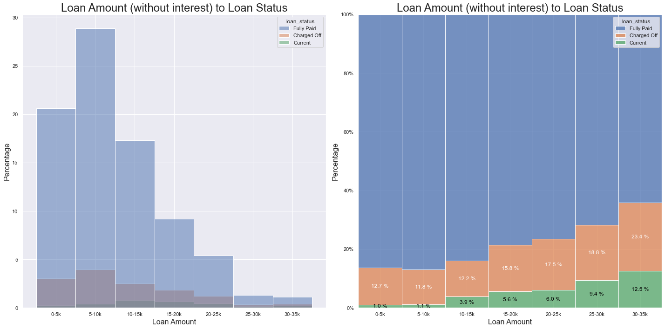
Analyzing Loan Amount to Loan Status
According to the Loan Amount to Loan Status Analysis, we can conclude the following, - When the Loan Amount is increasing, loan Charged Off percentage get increases

Slide 19
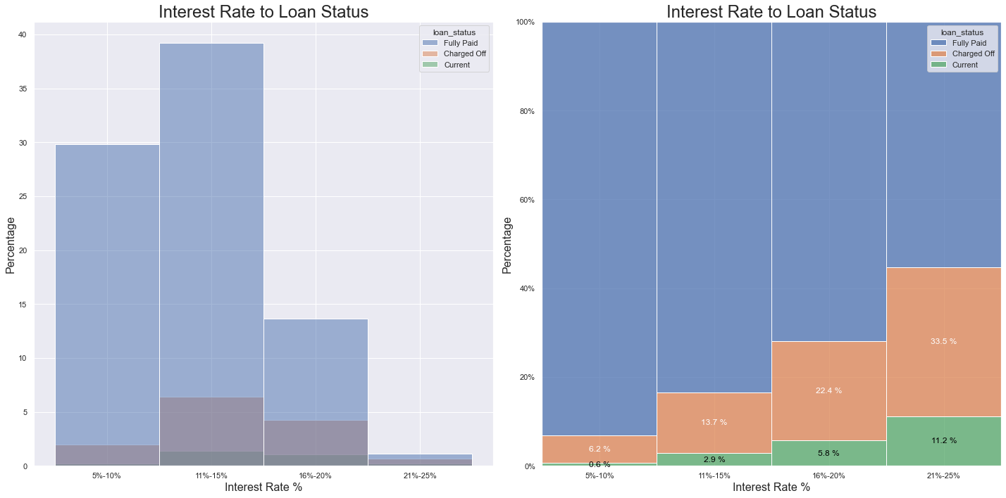
Analyzing Interest Rate to Loan Status
According to the Interest Rate to Loan Status Analysis, we can conclude the following, - When the loan Interest Rate is increasing, loan Charged Off percentage get increases

Slide 20
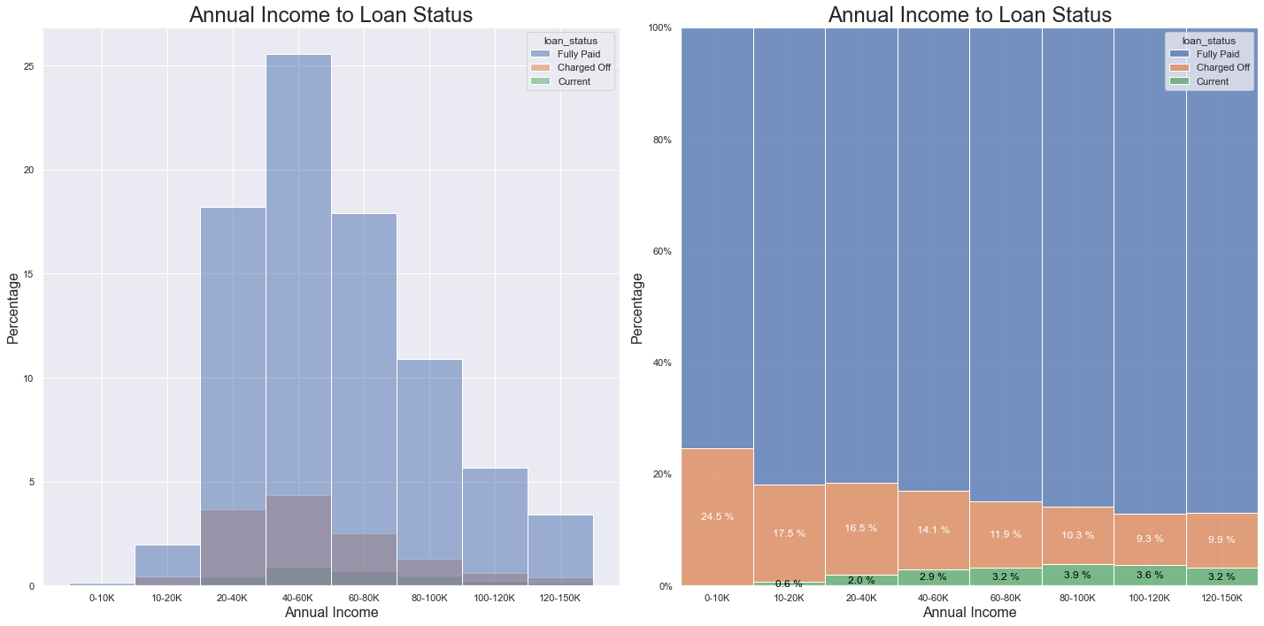
Analyzing Annual Income to Loan Status
According to the Annual Income to Loan Status Analysis, we can conclude the following, - When the Annual Income is increasing, loan Charged Off percentage get decreases

Slide 21
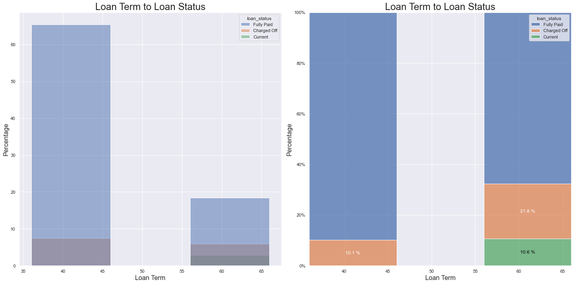
Analyzing Loan Term to Loan Status
According to the Loan Term to Loan Status Analysis, we can conclude the following, - When the Loan Term is increasing, loan Charged Off percentage get increases

Slide 22
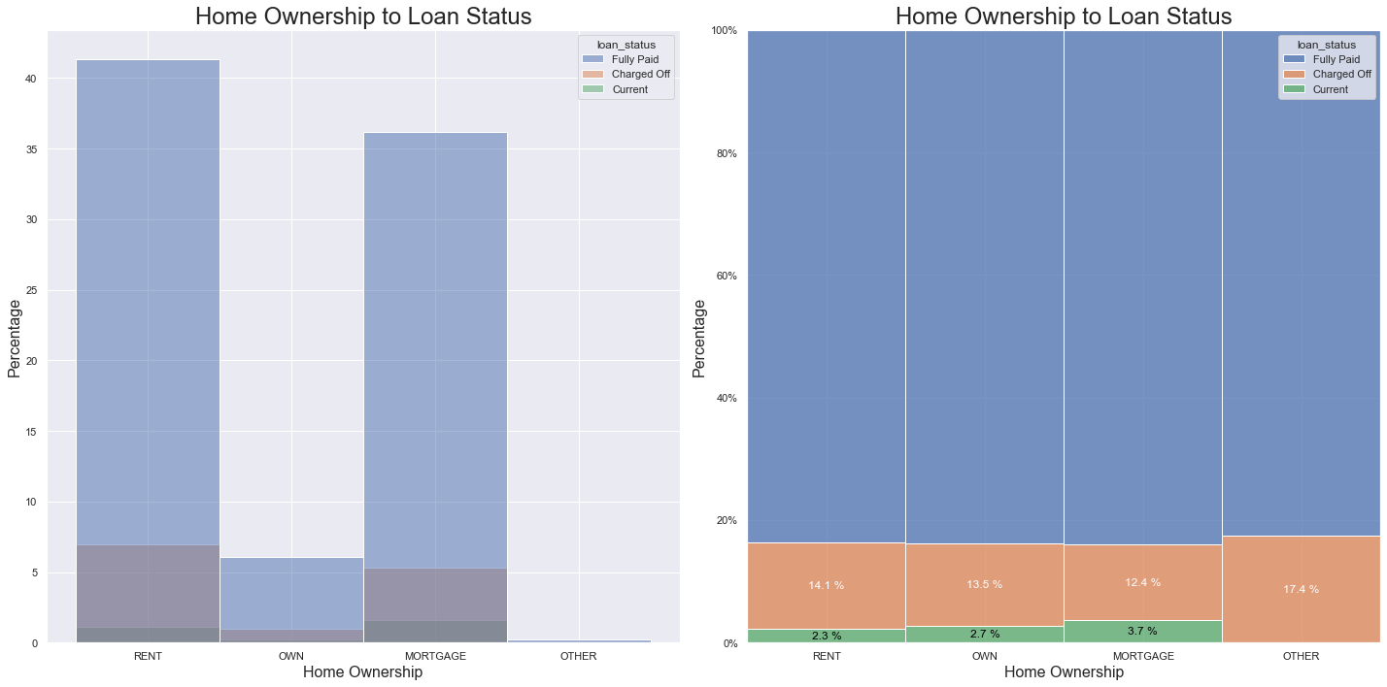
Analyzing Home Ownership to Loan Status
According to the Home Ownership to Loan Status Analysis, we can conclude the following, - When the borrower Home Ownership is other than Rent, Mortgage or Own, loan Charged Off percentage get increases

Slide 23
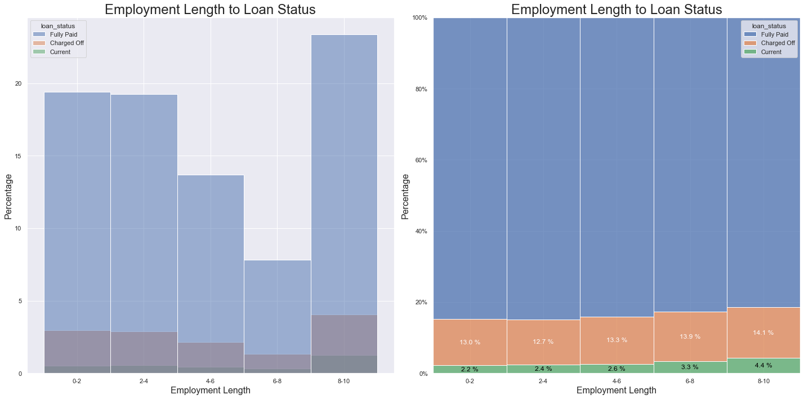
Analyzing Employment Length to Loan Status
According to the Employment Length to Loan Status Analysis, we can conclude the following, - When the Employment Length is increasing, loan Charged Off percentage get increases

Slide 24
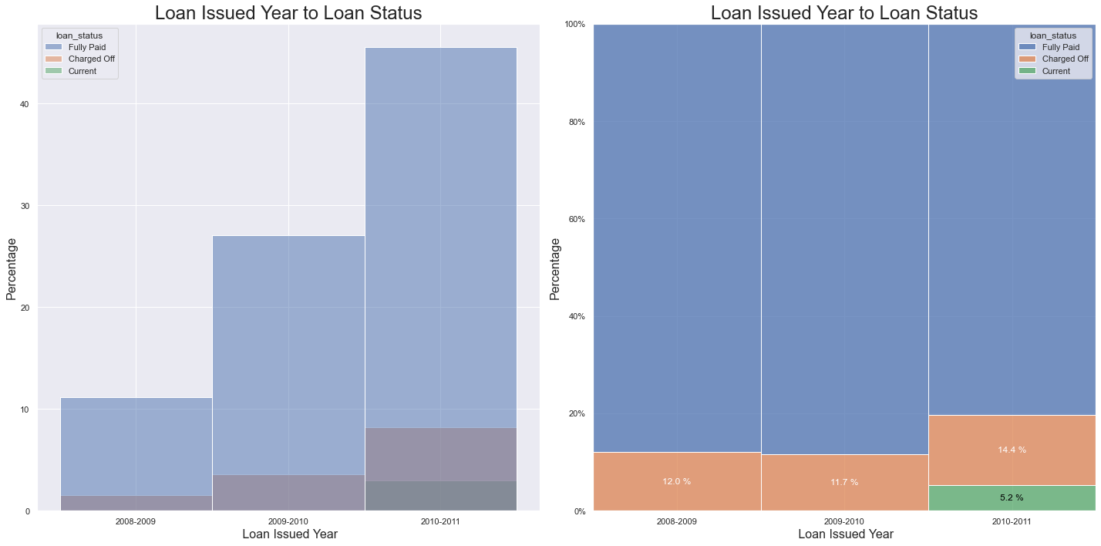
Analyzing Loan Issued Year to Loan Status
According to the Loan Issued Year to Loan Status Analysis, we can conclude the following, - Most of the loans got Charged Off, issued between year 2010 - 2011

Slide 25
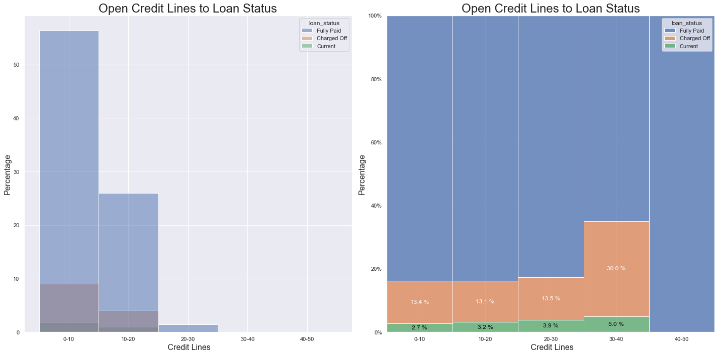
Analyzing Open Credit Lines to Loan Status
According to the Open Credit Lines to Loan Status, we can conclude the following, - When the Open Credit Lines is increasing, loan Charged Off percentage get increases

Slide 26
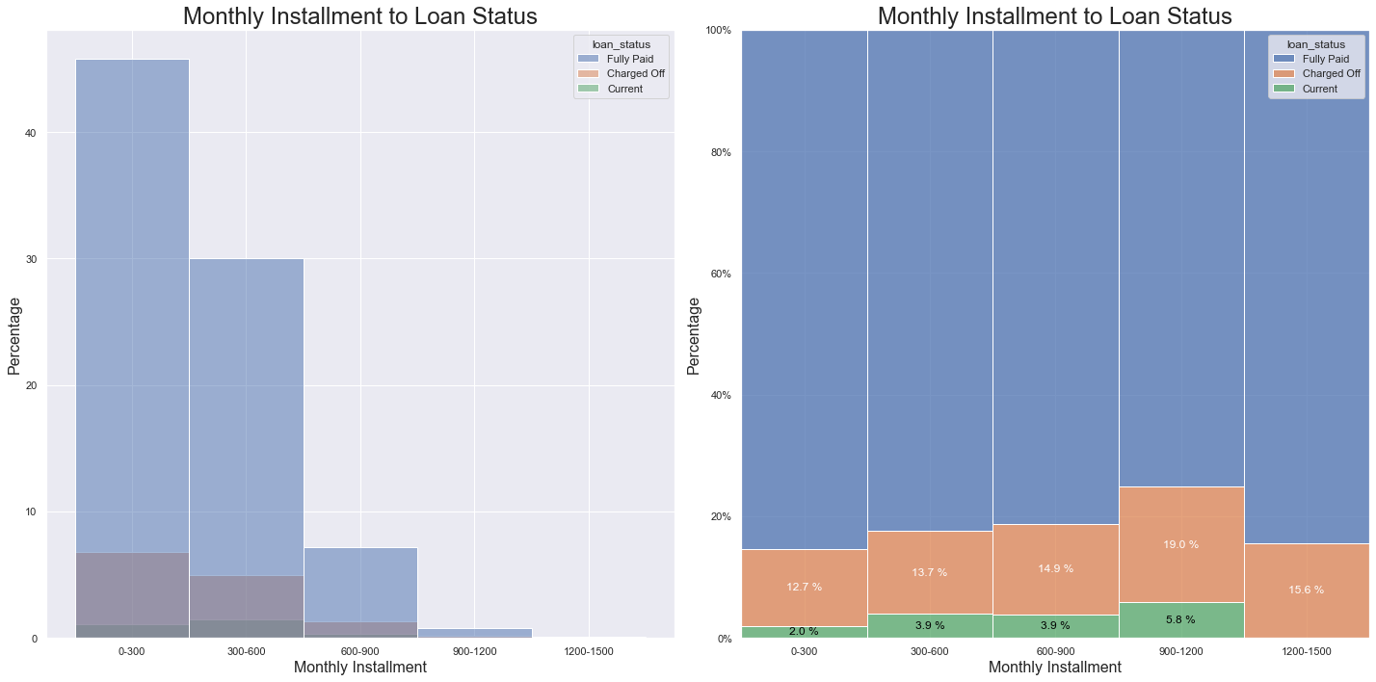
Analyzing Monthly Installment to Loan Status
According to the Monthly Installment to Loan Status, we can conclude the following, - When the Monthly Installment is increasing from 0 to 1200, loan Charged Off percentage get increases

Slide 27
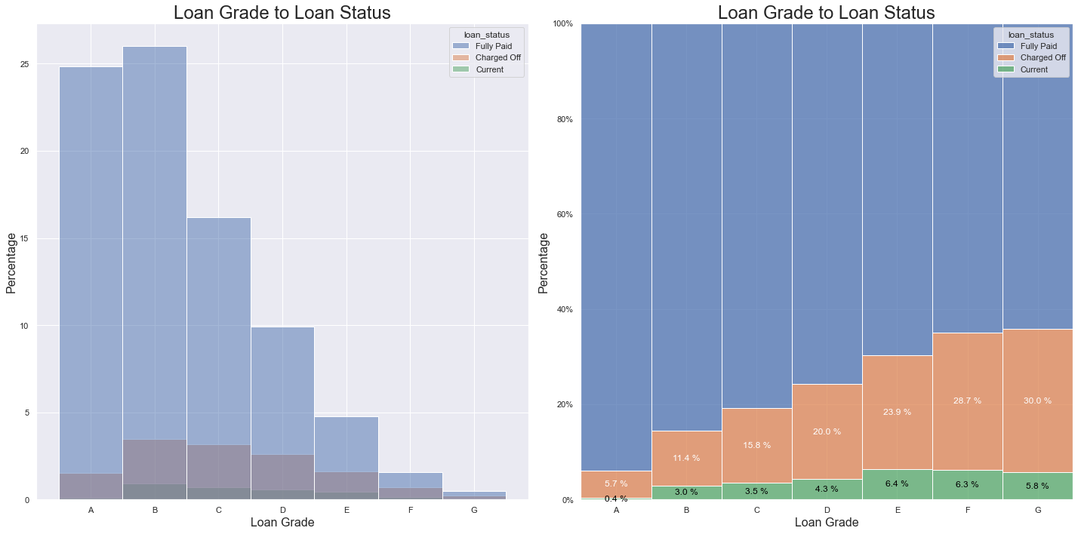
Analyzing Loan Grade to Loan Status
According to the Loan Grade to Loan Status Analysis, we can conclude the following, - When moving from grade A to G, loan Charged Off percentage get increases

Slide 28
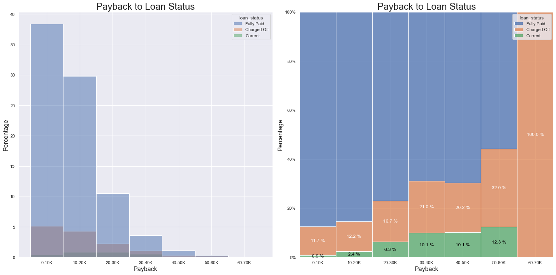
Analyzing Payback to Loan Status
Analyzing Payback to Loan Status​
According to the Payback to Loan Status Analysis, we can conclude the following, - When the Payback is increasing, loan Charged Off percentage get increases

Slide 29
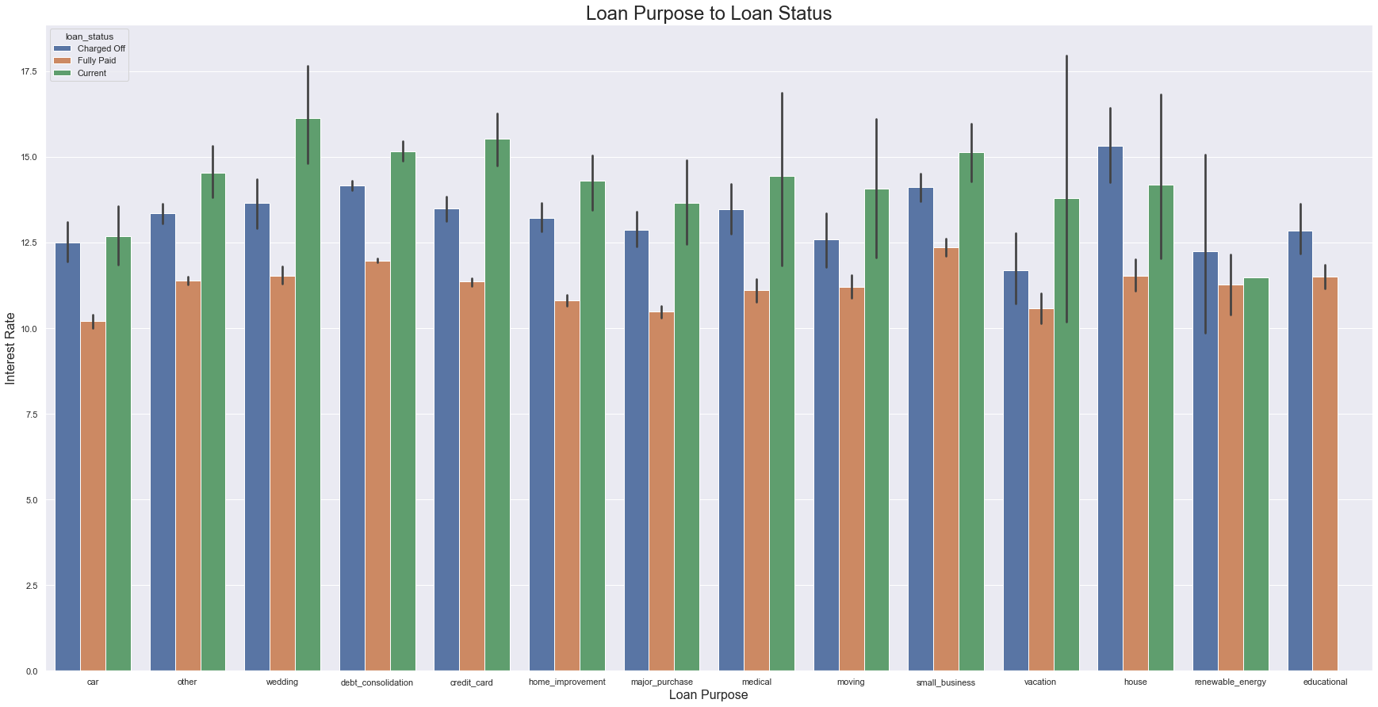
Analyzing Loan Purpose to Loan Status
According to the Loan Purpose to Loan Status, we can conclude the following, - Most of the loans Charged Off were borrowed for small business purposes

Slide 30
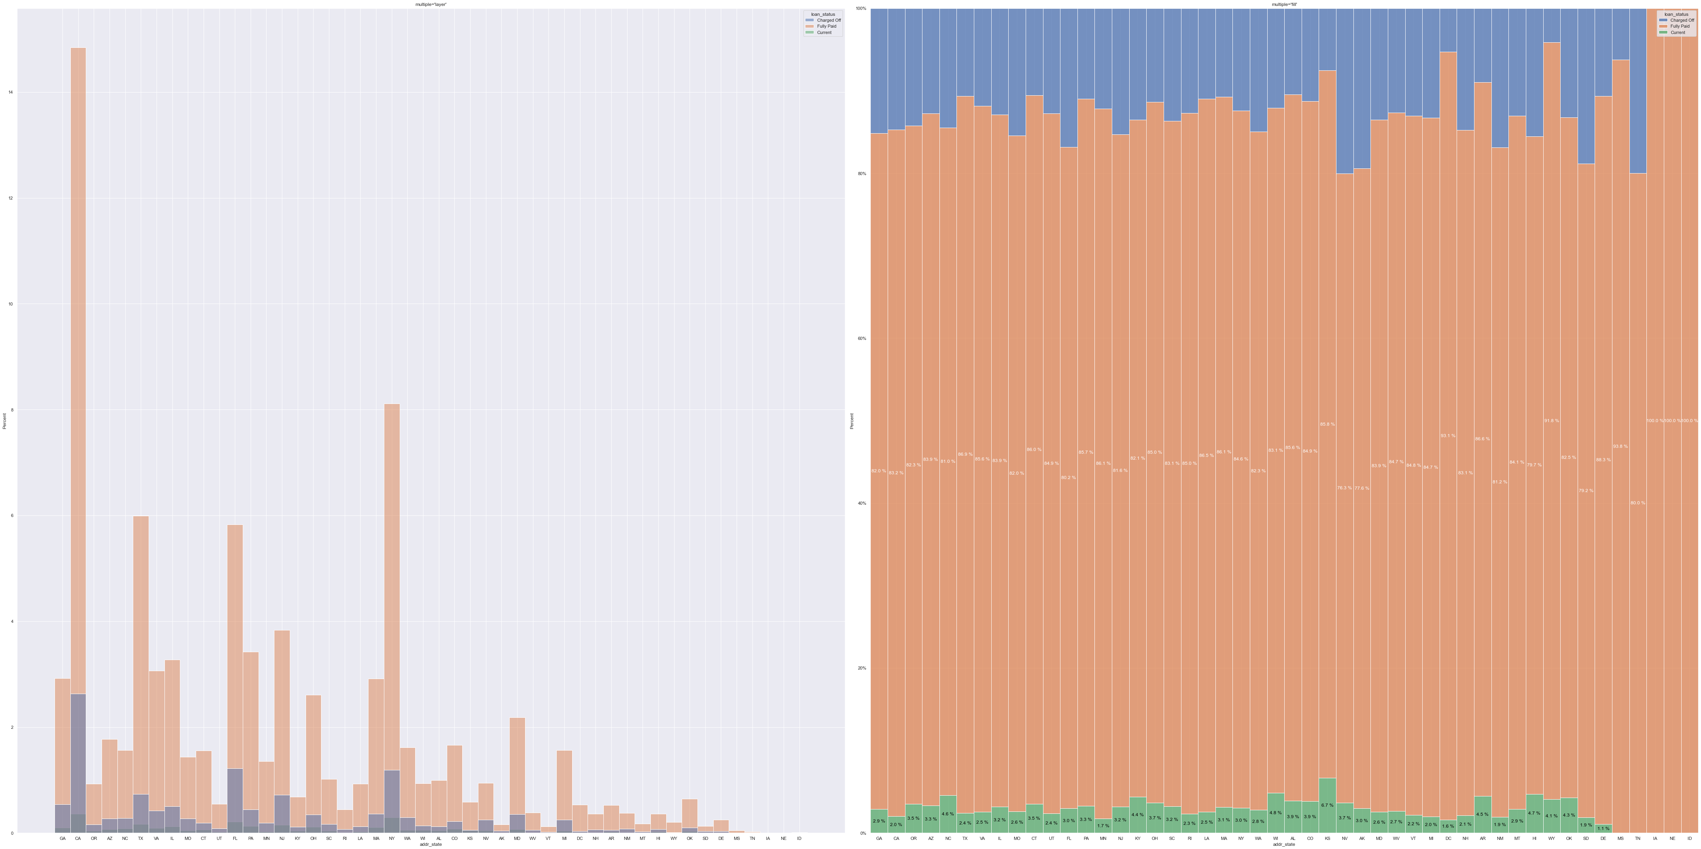
Analyzing State to Loan Status
According to the State to Loan Status, we can conclude the following, - State TN is the highest Charged Off state

Slide 31
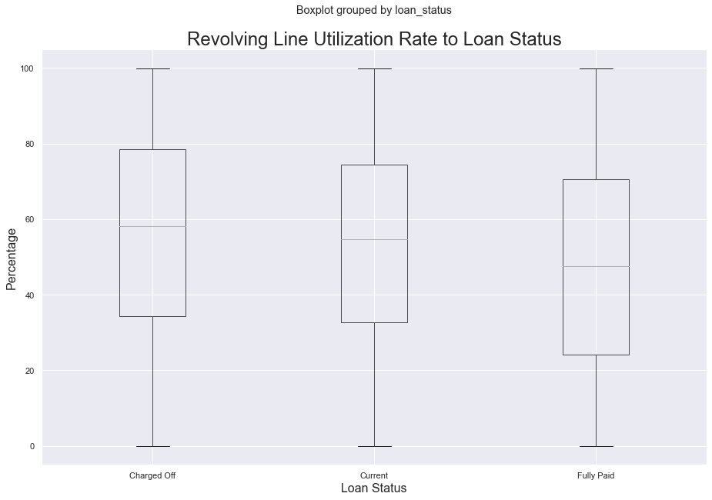
Analyzing Revolving Line Utilization Rate to Loan Status
According to the Revolving Line Utilization Rate to Loan Status, we can conclude the following, - When the Revolving Line Utilization Rate is increasing, loan Charged Off percentage get increases

Slide 32
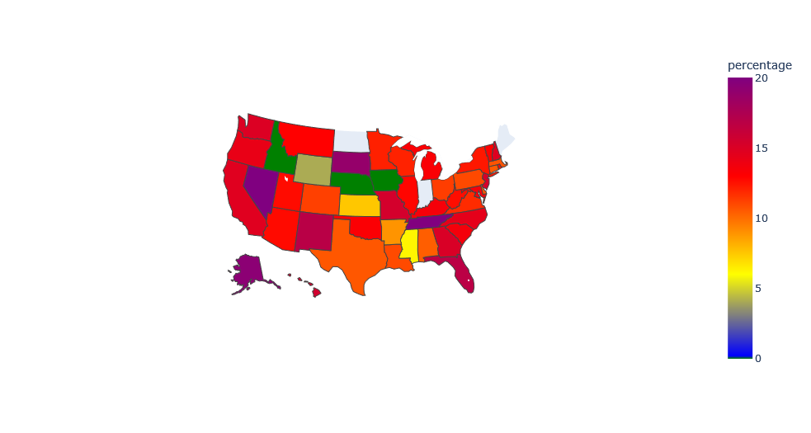
Loan State Wise Distribution

Slide 33
Recommendation
Annual income less than 20K at higher risk of defaulting
Loan amount higher than 25K at risk of defaulting
Higher the interest rate, higher the risk of defaulting
People who pick longer loan term is slightly higher risk than the lower term people
People on the Home Ownership status ‘Other’ is at slightly higher risk than other
Overall loan(including interest) : As the loan gets higher the risk increases people are higher than 50K overall payback is at high risk.

Slide 34
Recommendation (Continued.)
People with open credit lines of 30-40 are at higher risk
Smaller business is at higher risk of defaulting
As the revolving line utilization increases the risk of defaulting increases
As the ratio of income to debt gets closer the risk of defaulting gets higher.
It's recommended to introduce an point based system to assess the risk of being defualted

Slide 35
Payment Expected with Interest: 454,362,431.76 Payment Expected without Interest: 364,618,850.00 Payment Received: 396,578,430.16 Expected Profit: 89,743,581.76 Loss Due to Defaulting: 57,784,001.60 Actual profit: 31,959,580.16 Profit Achieved to Expected: 35.61% Company Profit to investment: 8.77% Expected Company Profit to investment: 24.61%
Lending Performance Summary

Slide 36

Thank You

